Slide 1

Policy
Path
DATA HAWKS
(Joseph Valencia, Joshua Alonso,
Jose Hernandez)
Notes:
Hello everyone, I’m ___, I’m ____. I’m _____, and we are the Data Hawks. This is our presentation on Policy Path, a potential new way for patients to visualize their healthcare options.

Slide 2
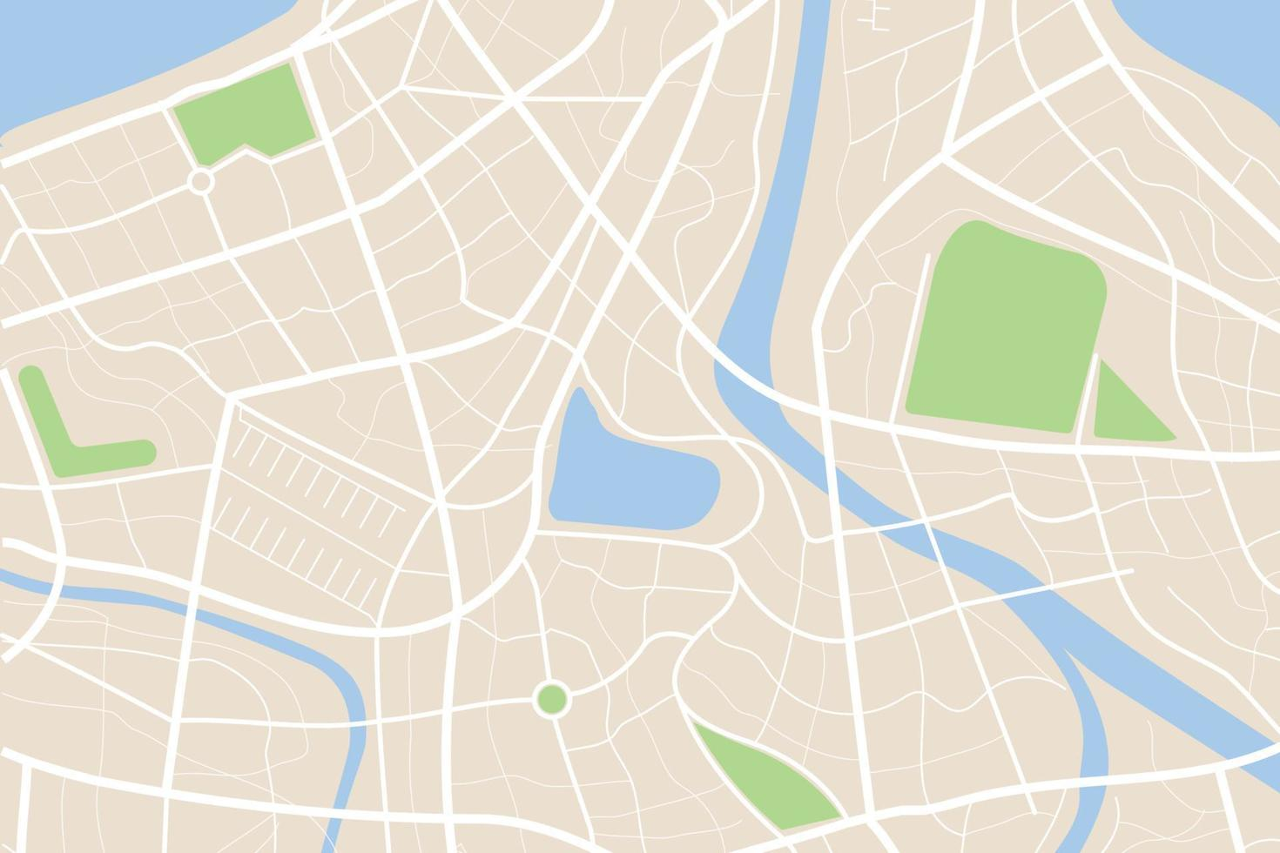
The Problem: Misinformation leading to denial of care at clinics due to Insurance coverage misunderstanding
54% of patients have had difficulty affording their insurance
71% of respondents did not know if their health plan offered them access to telehealth services.
Lack of engagement in patients with clinics
Difficulty finding in-network providers
Notes:
We set out with the task of finding a solution to the very prominent issue for many patients. Whether they’re young new patients entering the healthcare system for the first time or older individuals who’ve just been switched to a new plan, many people every year suffer from misinformation leading to denial of care at clinics, typically due to insurance coverage misunderstandings. We wish to make an accessible way for people to find care that’s covered by their insurance.

Slide 3

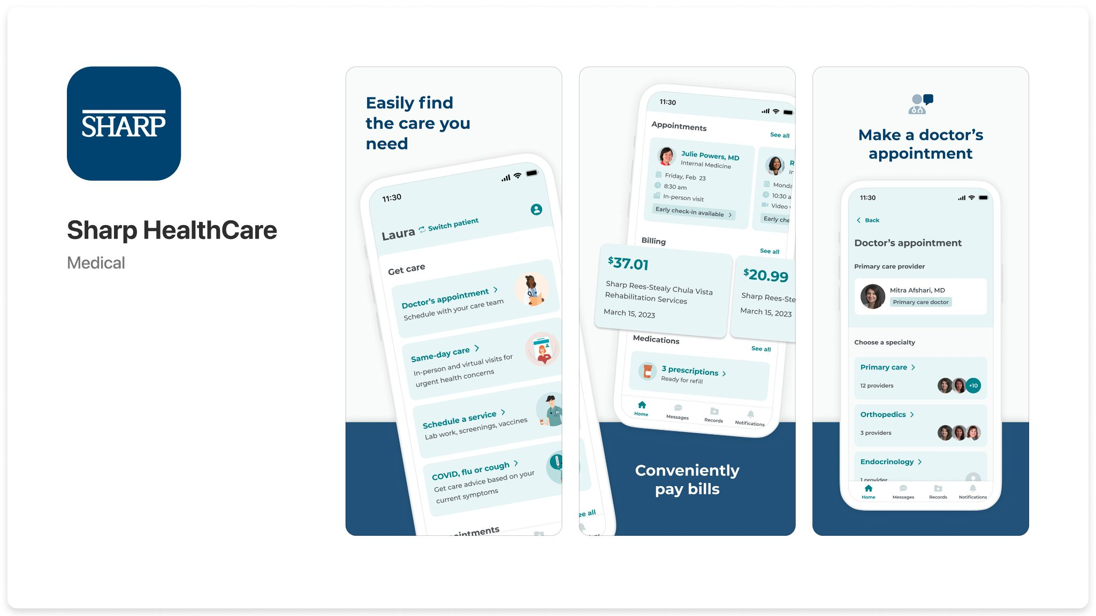
Pre-Existing Services
Notes:
Currently, what patients have available are healthcare apps that provide listings of potential healthcare locations. The Sharp App, for example, lists the all the possible nearby locations where the patient can find Sharp covered medical care, whether it be routine testing or emergency care. It displays this info in the form of a list of names and addresses, but it doesn’t quite provide the user with a sense of place or any information regarding capacity, pricing, hours, or other crucial details necessary for figuring out whether or not you should go there. It also only lists Sharp affiliated centers, but if a user is part of another medical group then they will need another app. Conversely, map services like Zocdoc do provide an accessible list of healthcare locations in map form, but they don’t take into account insurance information or provide the same live updates that the medical apps provide. We seek to reconcile these differences to make an all-in-one-place medical map app.

Slide 4
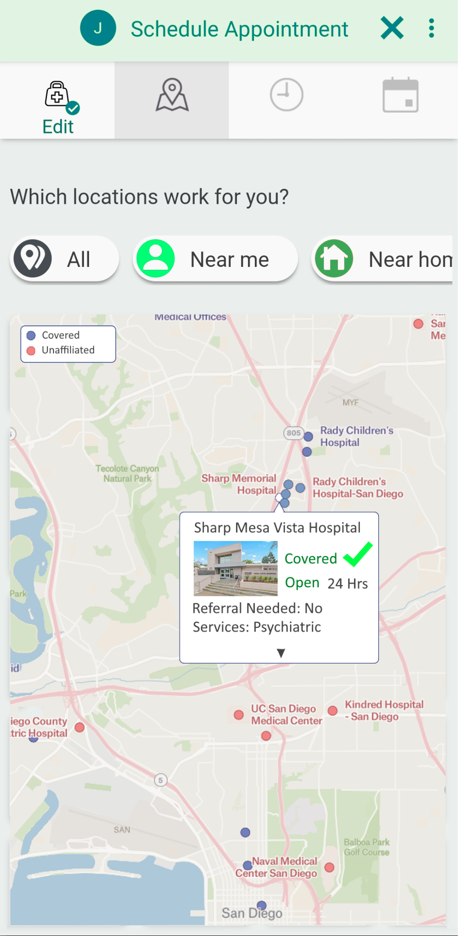
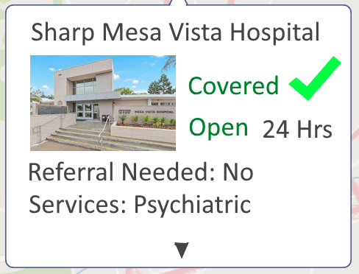
Our Solution
An app to find clinics with your specific insurance
Allows users to:
Book appointments, Get directions, check wait times,... etc
Enhanced decision making
Cost transparency
Notes:
Our solutions provides users with a nice integrated map with clinics that support your insurance provider. In order to ensure that patients don’t get turned away at the front desk, we will provide users with all the information they need in order to figure out what locations are accessible to them. Our software will be powered by Google Maps and a combination of medical group databases in order to give an easily navigable experience and relevant information. By giving them everything they need to know before they show up, we’re allowing patients new and old to find care with confidence.

Slide 5

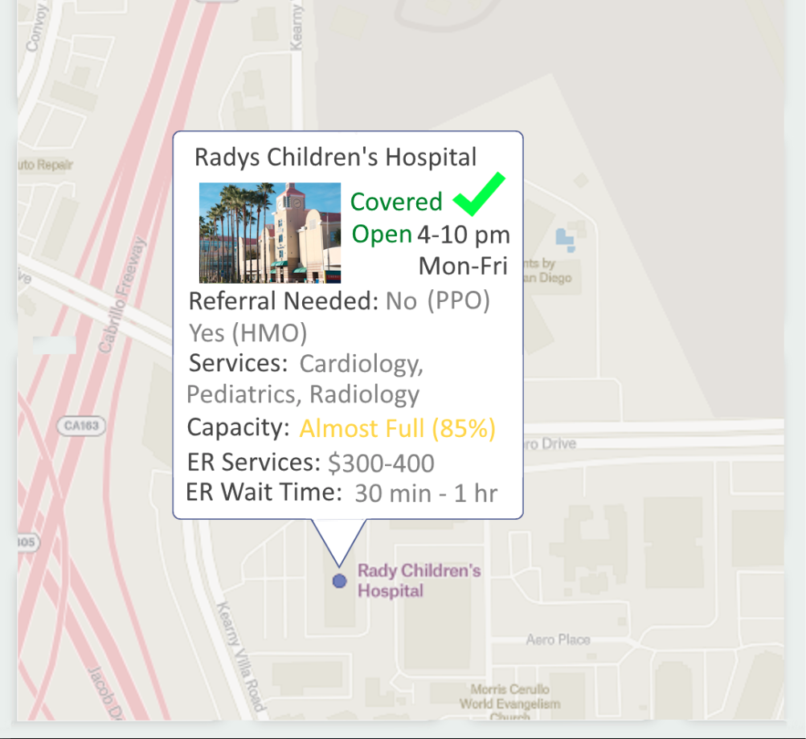
Accessibility
Notes:
We will first ask users to input their healthcare plan and information to set up their profile, and based on this info the map will highlight different clinics and hospitals that are within range and covered by your insurance. At a glance, the user will have all their accessible options available to them, and when they tap a center, they can see more information to help them decide which location is right for them. From there, they will be able to book appoints, call, or get directions. We will use the most up-to-date data from all participating healthcare providers in order to provide live updates on information such as capacity, price estimates, or wait times. We will provide additional information and filters that can be enabled to narrow down a user’s search for the right place with the hope that every patient who needs care will get it.

Slide 6
Thank You

Slide 7
References:
https://www.usnews.com/opinion/articles/2023-08-08/health-insurance-barriers-delay-disrupt-and-deny-patient-care

